Slide 1

Capstone project Starting a grocery store in Dallas, Texas
Jianing He
May 2020

Slide 2
Introduction
Dallas City, Texas
High population
More than 1Million
9th ranking in the U.S.
Diverse economy:
Defense
Financial services
Information technology
Telecommunications
Transportation
More than $8.4 million given to four grocery anchored developments

Slide 3
Data Sources
List of neighborhoods in Dallas
Geographical coordinates of the neighborhoods
Latitude
longitude
Venue data from Foursquare API

Slide 4
Methodology
Neighborhood Data scraping from Wikipedia
Latitude and longitude of the Neighborhood with Geocoder package
Map visualization of Dallas Neighborhoods
Venues data requested from Foursquare API
Cluster Neighborhoods with k-means algorithm
Map visualization of clustered Dallas Neighborhoods

Slide 5
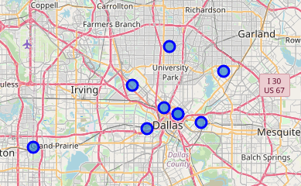
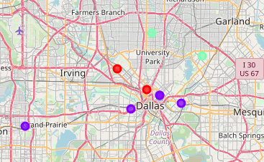
Results
Map visualization of Dallas Neighborhoods
Map visualization of clustered Dallas Neighborhoods

Slide 6
Results
Map visualization of clustered Dallas Neighborhoods
- moderate number of Grocery Stores
- low number to no existence of Grocery Stores – recommended !!!!
- high concentration of Grocery Stores

Slide 7
Thank YOU!

